Slide 1

LCD and I2C Interface with 8051 (8051 -5 Days Workshop)
DAY 9
EMBEDDED SYSTEM DESIGN & IoT-Master Class

Slide 2
What You will learn Today?
Introduction to LCD
Pin details and Descriptions
Schematics
Program
Introduction to I2C
How it works
Schematics
Program

Slide 3
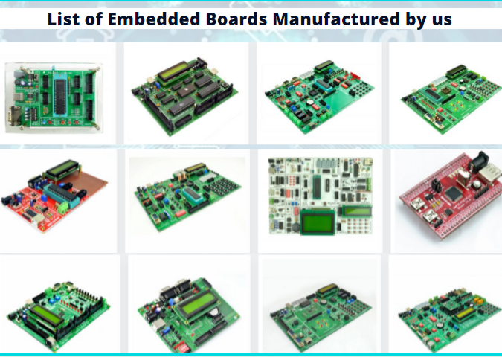
About Pantech
Started in the Year 2004
Lab equipments and Sensor Interface
Manufacturer of Brainsense EEG Headset
Reconfigurable Algorithms on AI
Manufacture of AI development Boards
Power electronics, Fuel cell and Renewable Energy trainers
www.pantechsolutions.net

Slide 4

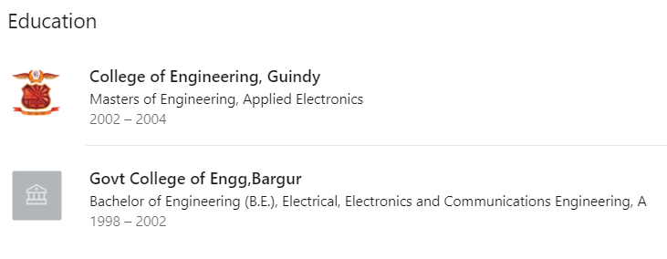
About me
My Primary Expertise
Microcontroller Architecture: 8051,PIC,AVR,ARM,MSP430,PSOC3 DSP Architecture: Blackfin,C2000,C6000,21065L Sharc FPGA: Spartan,Virtex,Cyclone Image Processing Algorithms: Image/Scene Recognition, Machine Learning, Computer Vision, Deep Learning, Pattern Recognition, Object Classification ,Image Retrieval, Image enhancement and denoising. Neural Networks : SVM,RBF,BPN Cryptography :RSA,DES,3DES,Ellipti curve,Blowfish,Diffe Hellman Compilers: Keil,Visual DSP++,CCS, Xilinx Platform studio,ISE, Matlab, Open CV
https://www.linkedin.com/in/jeevarajan/
www.pantechsolutions.net

Slide 5
Announcement
Attendance Link at 9 pm
Minimum attendance required for an E-Certificate is 27 Days. Attendance link will be valid for 1 hrs. after the event.
For Internship Candidates no attendance required ,it will be accessed from the LMS Portal. (learn.pantechsolutions.net)
Recorded Video Streaming for LAB classes to improve Learning Experience
8051 – 5 Days workshop –use the same attendance form
support.pantechsolutions.net

Slide 6

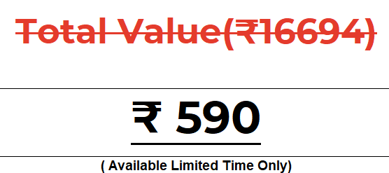
What you get on 30 Days Internship

Slide 7
Mindset Lesson for the Day
Taking ACTION Towards goal is the Key step to Success.
If You Don't Fill Your Day With High Priority Actions, It Will Automatically Gets Filled With Low Priority Distractions
Exercise
Write down all the things that create RESISTANCE in the process of you taking action.

Slide 8
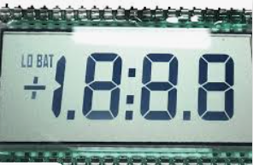
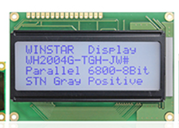
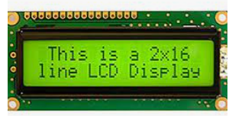
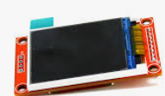

What is LCD
A liquid-crystal display (LCD) is a flat-panel display or other electronically modulated optical device that uses the light-modulating properties of liquid crystals combined with polarizers. Liquid crystals do not emit light directly,[1] instead using a backlight or reflector to produce images in color or monochrome

Slide 9
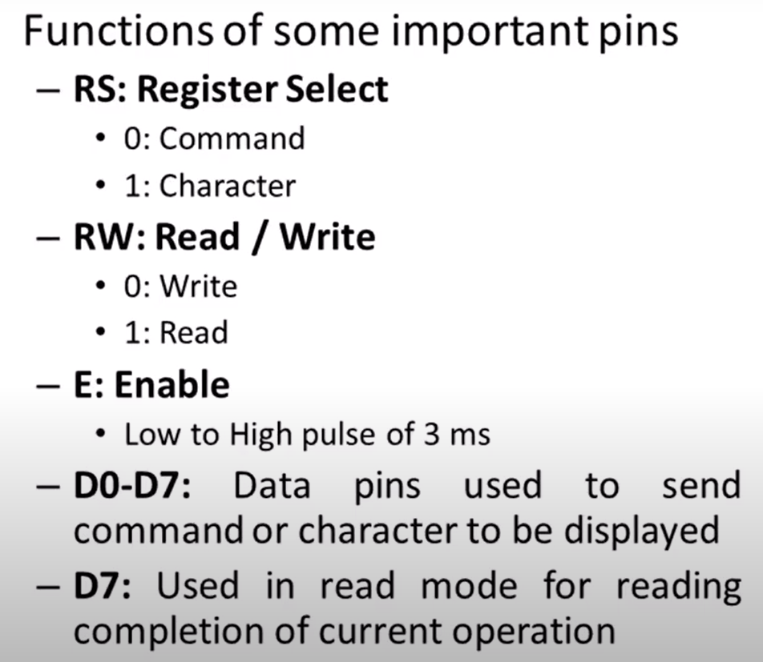
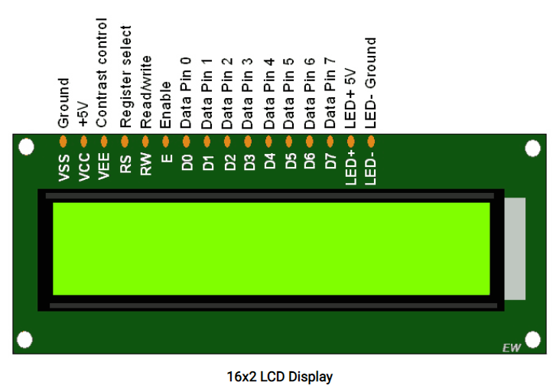
PIN Details of LCD

Slide 10
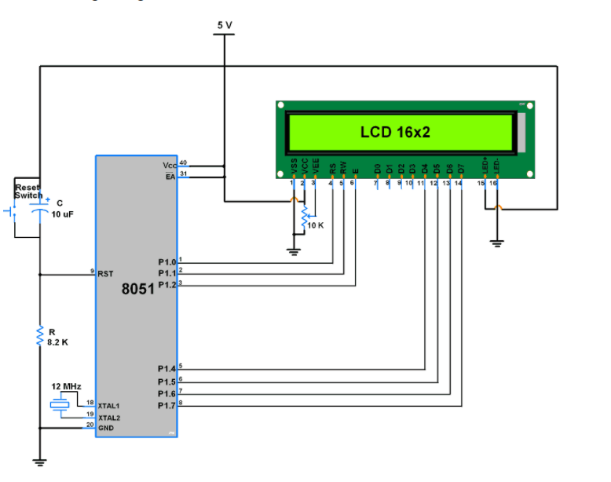
Schematic Diagram of LCD

Slide 11
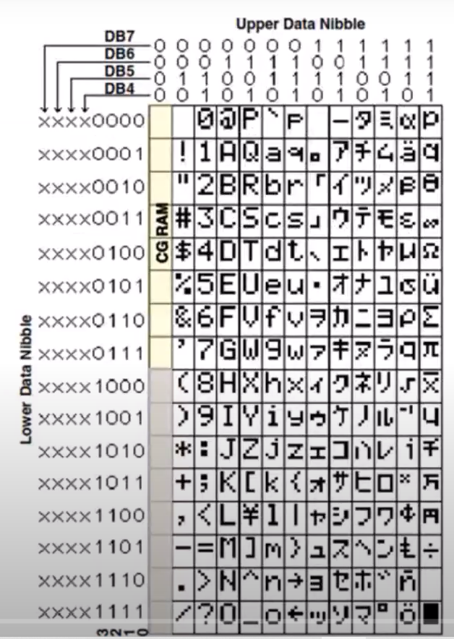
Character Display LCD
0011 0001 -X”31”
0011 0010 -X”32”

Slide 12
Step 1-Initialize LCD
Initialization
Wait for 15ms, Power-on initialization time for LCD16x2.
Send 0x02 command which initializes LCD 16x2 in 4-bit mode.
Send 0x28 command which configures LCD in 2-line, 4-bit mode, and 5x8 dots.
Send any Display ON command (0x0E, 0x0C)
Send 0x06 command (increment cursor)

Slide 13
Header files and Declarations
#include <reg51.h> //Define 8051 Registers
#include <stdio.h> //Define I/O Functions
#define DATA P0 //Define DATA to Port2
//Define control pins
sbit RS = P0^0; //Register Select
sbit RW = P0^1; //LCD Read/Write
sbit lcd_e = P0^2; //LCD Enable
unsigned char msg[] = ("A"); //Display the message
unsigned char msg1[] = ("CD");

Slide 14
LCD functions
void lcd_init(void);
void lcd_cmd(unsigned char);
void lcd_display(unsigned char);
void DelayMs(int);

Slide 15
LCD Command
void lcd_cmd(unsigned char cmnd)
{
DATA = 0xf0&cmnd; // Send upper nibble
RS = 0; RW = 0;
lcd_e = 1;
DelayMs(35);
lcd_e = 0;
DATA = cmnd<< 4; //send lowe nibble
RS = 0; RW = 0;
lcd_e = 1;
DelayMs(35);
lcd_e = 0;
}

Slide 16
LCD DISPLAY
void lcd_display(unsigned char dat)
{
DATA = 0xf0&dat; /// Send upper nibble
RS = 1; RW = 0;
lcd_e = 1;
DelayMs(35);
lcd_e = 0;
DATA = dat<< 4; //send lowe nibble
RS = 1; RW = 0;
lcd_e = 1;
DelayMs(35);
lcd_e = 0;
}

Slide 17
Delay
void DelayMs(int k)
{
unsigned int a;
for(a=0;a<=k;a++);
}

Slide 18
void lcd_init(void)
{
unsigned char i;
lcd_cmd(0x28); //2x16 Character 5x7 dot
DelayMs(15); //matrix LCD,4-bit format
lcd_cmd(0x0c); //Display On, cursor off
DelayMs(15);
lcd_cmd(0x06); //Shift Cursor to right
DelayMs(15);
lcd_cmd(0x01); //Clear display screen
DelayMs(15);
DelayMs(6000);
//-------------------------------------------
// First Line Message Display
//-------------------------------------------
lcd_cmd(0x80); //First Line Initialization
DelayMs(35);
i=0;
while(msg[i]!='\0')
{
lcd_display(msg[i]);
i++;
}
DelayMs(50);
//-------------------------------------------
// Second Line Message Display
//-------------------------------------------
lcd_cmd(0xc0); //Second Line Initialization
DelayMs(35);
i=0;
while(msg1[i]!='\0')
{
lcd_display(msg1[i]);
i++;
}
DelayMs(50);
}

Slide 19
Main
void main(void)
{
P0 = 0;
lcd_init(); //LCD Initialization
DelayMs(1);
DelayMs(1);
while(1); //Loop Forever
}

Slide 20
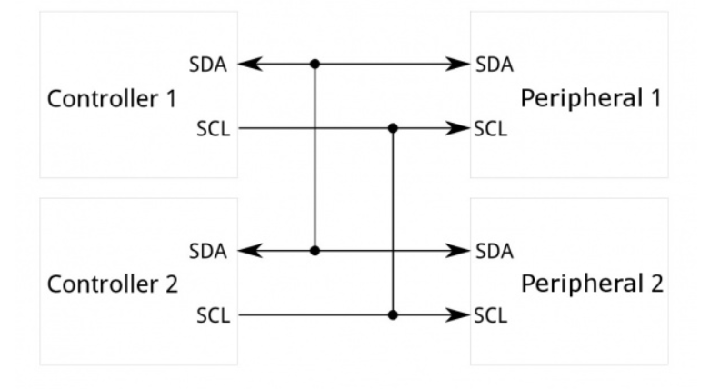
What is IIC
I²C requires a mere two wires, like asynchronous serial, but those two wires can support up to 1008 peripheral devices. Also, unlike SPI, I²C can support a multi-controller system, allowing more than one controller to communicate with all peripheral devices on the bus (although the controller devices can't talk to each other over the bus and must take turns using the bus lines).

Slide 21
Why Use I2C?
Disadvantage of Serial Port(UART)
serial ports are asynchronous (no clock data is transmitted), devices using them must agree ahead of time on a data rate. The two devices must also have clocks that are close to the same rate
Another core fault in asynchronous serial ports is that they are inherently suited to communications between two, and only two, devices. While it is possible to connect multiple devices to a single serial port, bus contention (where two devices attempt to drive the same line at the same time)
Disadvantage of SPI
The most obvious drawback of SPI is the number of pins required. Connecting a single controller ^{[1]} to a single peripheral ^{[1]} with an SPI bus requires four lines; each additional peripheral device requires one additional chip select I/O pin on the controller.
SPI only allows one controller on the bus,

Slide 22
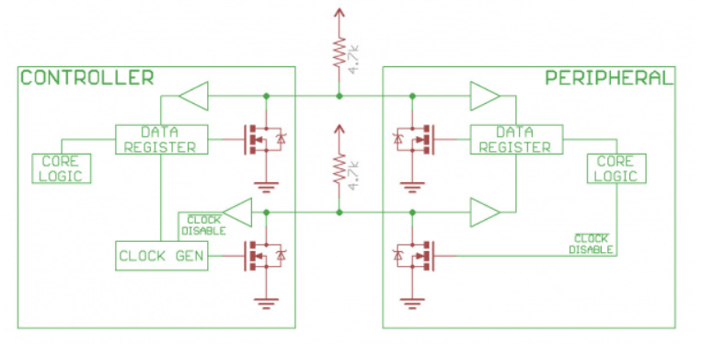
I2C is Open Drain
UART or SPI connections, the I2C bus drivers are "open drain", meaning that they can pull the corresponding signal line low, but cannot drive it high. Thus, there can be no bus contention where one device is trying to drive the line high while another tries to pull it low, eliminating the potential for damage to the drivers or excessive power dissipation in the system. Each signal line has a pull-up resistor on it, to restore the signal to high when no device is asserting it low.

Slide 23
Features of I2C
Half-duplex Communication Protocol
Bi-directional communication is possible but not simultaneously.
Synchronous Communication – The data is transferred in the form of frames or blocks.
Can be configured in a multi-master configuration.
Arbitration – I2C protocol supports multi-master bus system but more than one bus can not be used simultaneously. The SDA and SCL are monitored by the masters. If the SDA is found high when it was supposed to be low it will be inferred that another master is active and hence it stops the transfer of data.
Serial transmission I2C uses serial transmission for transmission of data.
Used for low-speed communication.
Clock Stretching The clock is stretched when the slave device is not ready to accept more data by holding the SCL line low, hence disabling the master to raise the clock line. Master will not be able to raise the clock line because the wires are AND wired and wait until the slave releases the SCL line to show it is ready to transfer next bit.

Slide 24
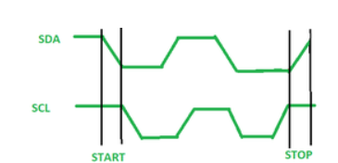
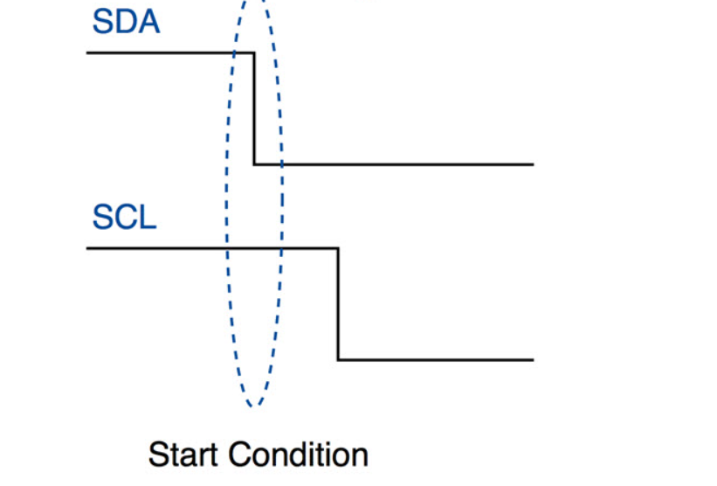
Start
Start Condition: The SDA line switches from a high voltage level to a low voltage level before the SCL line switches from high to low.

Slide 25
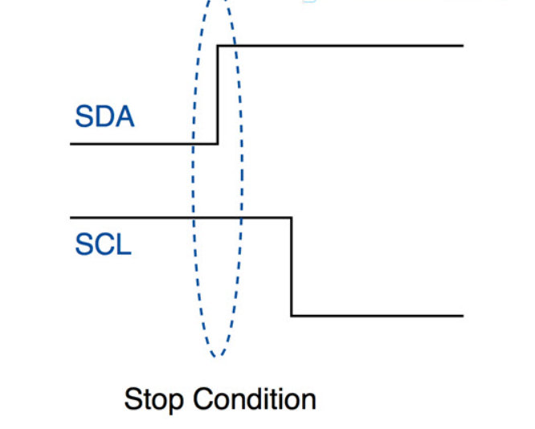
Stop
After required data blocks are transferred through the SDA line, the master device switches the SDA line from low voltage level to high voltage level before the SCL line switches from high to low.

Slide 26
I2C – How it works
The master device sends the start condition
The master device sends the 7 address bits which corresponds to the slave device to be targeted
The master device sets the Read/Write bit to ‘0’, which signifies a write
Now two scenarios are possible:
If no slave device matches with the address sent by the master device, the next ACK/NACK bit stays at ‘1’ (default). This signals the master device that the slave device identification is unsuccessful. The master clock will end the current transaction by sending a Stop condition or a new Start condition
If a slave device exists with the same address as the one specified by the master device, the slave device sets the ACK/NACK bit to ‘0’, which signals the master device that a slave device is successfully targeted
If a slave device is successfully targeted, the master device now sends 8 bits of data which is only considered and received by the targeted slave device. This data means nothing to the remaining slave devices
If the data is successfully received by the slave device, it sets the ACK/NACK bit to ‘0’, which signals the master device to continue
The previous two steps are repeated until all the data is transferred
After all the data is sent to the slave device, the master device sends the Stop condition which signals all the slave devices that the current transaction has ended

Slide 27
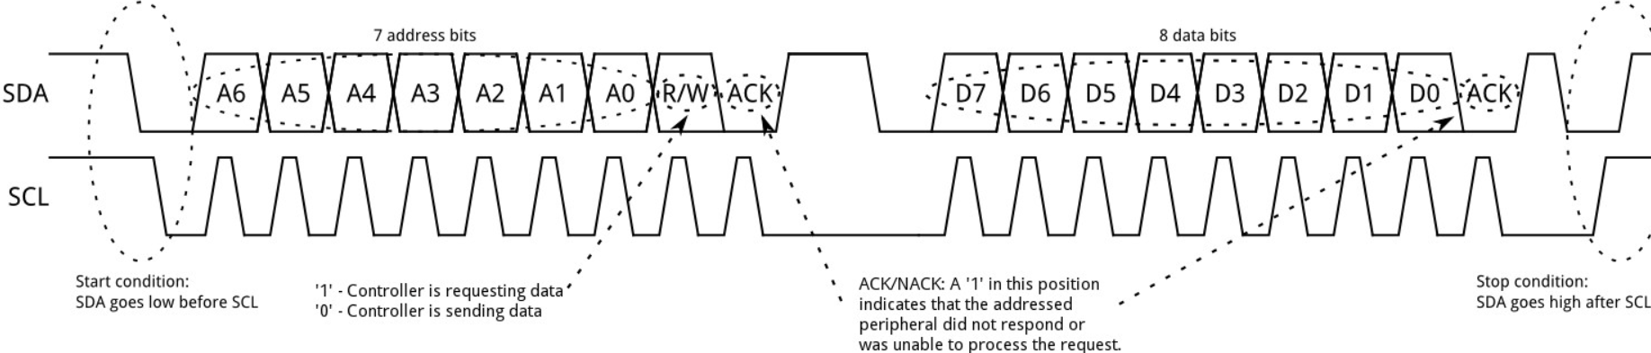
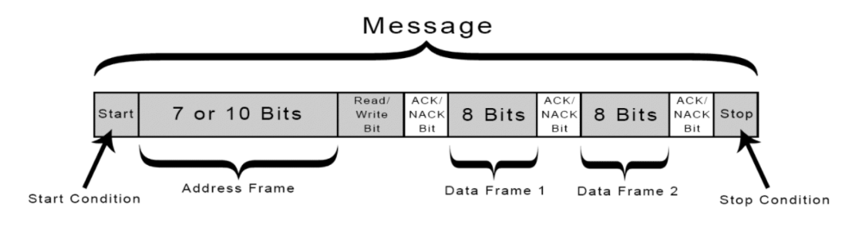
I2C – How it works

Slide 28
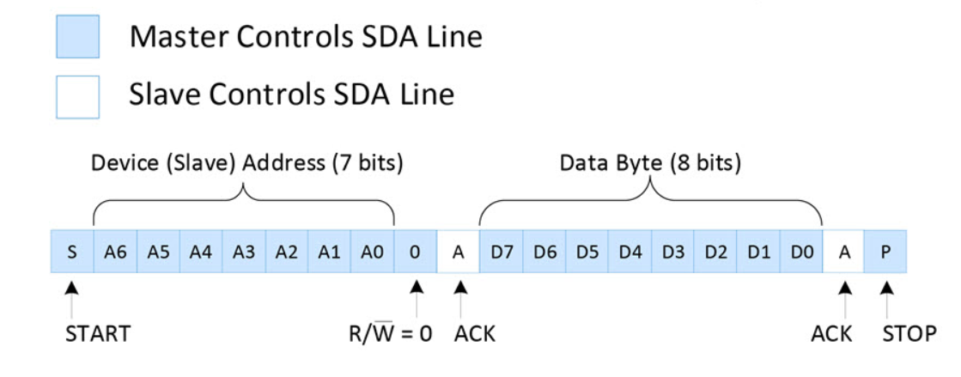
Sending Data to a Slave Device

Slide 29
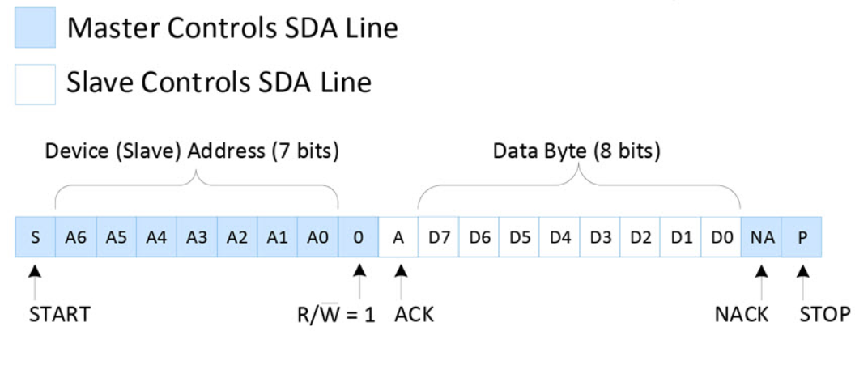
Reading Data from a Slave Device

Slide 30
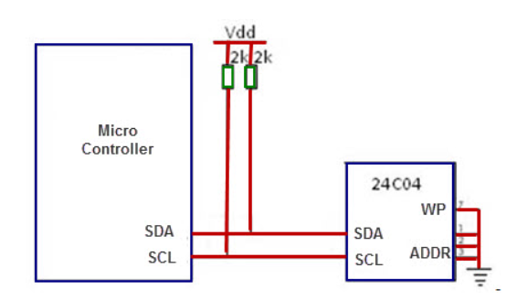
Circuit Diagram

Slide 31
Header file and definitions
#include<reg51.h>
#include<stdio.h>
#include<intrins.h>
#define ACK 1
#define NO_ACK 0

Slide 32
Declarations
unsigned char EData[5];
unsigned char Data;
void InitSerial(void);
void DelayMs(unsigned int);
void WriteI2C(unsigned char);
unsigned char ReadI2C(bit);
void Start(void);
void Stop(void);
void ReadBYTE(unsigned int);
void WriteBYTE(unsigned int);
sbit SCL = P2^0; // connect to SCL pin (Clock)
sbit SDA = P2^1; // connect to SDA pin (Data)

Slide 33
void InitSerial(void)
void InitSerial(void)
{
SCON = 0x52; // setup serial port control
TMOD = 0x20; // hardware (9600 BAUD @11.0592MHZ)
TH1 = 0xFD; // TH1
TR1 = 1; // Timer 1 on
}

Slide 34
void Start(void)
void Start(void)
{
SDA = 1;
SCL = 1;
_nop_();_nop_();
SDA = 0;
_nop_();_nop_();
SCL = 0;
_nop_();_nop_();
}

Slide 35
void Stop(void)
void Stop(void)
{
SDA = 0;
_nop_();_nop_();
SCL = 1;
_nop_();_nop_();
SDA = 1;
}

Slide 36
Write I2C
void WriteI2C(unsigned char Data)
{
unsigned int i;
for (i=0;i<8;i++)
{
SDA = (Data & 0x80);
SCL=1;SCL=0;
Data<<=1;
}
SCL = 1;
_nop_();_nop_();
SCL = 0;
}

Slide 37
Read I2C
unsigned char ReadI2C(bit ACK_Bit)
{
unsigned int i;
Start();
WriteI2C(0xA1);
SDA = 1;
for (i=0;i<8;i++)
{
SCL = 1;
Data<<= 1;
Data = (Data | SDA);
SCL = 0;
_nop_();
}
if (ACK_Bit == 1)
SDA = 0; // Send ACK
else
SDA = 1; // Send NO ACK
_nop_();_nop_();
SCL = 1;
_nop_();_nop_();
SCL = 0;
Stop();
return Data;
}

Slide 38
Read byte from I2C
void ReadBYTE(unsigned int Addr)
{
Start();
WriteI2C(0xA0);
WriteI2C((unsigned char)(Addr>>8)&0xFF);
WriteI2C((unsigned char)Addr&0xFF);
}

Slide 39
Write byte from I2C
void WriteBYTE(unsigned int Addr)
{
Start();
WriteI2C(0xA0);
WriteI2C((unsigned char)(Addr>>8)&0xFF); // send address high
WriteI2C((unsigned char)Addr&0xFF); // send address low
}

Slide 40
Delay
void DelayMs(unsigned int count)
{ // mSec Delay 11.0592 Mhz
unsigned int i; // Keil v7.5a
while(count)
{
i = 110;
while(i>0) i--;
count--;
}
}

Slide 41
void main(void)
{
unsigned int i;
InitSerial(); // Initialize serial port
putchar(0x0C); // clear hyper terminal
DelayMs(5);
WriteBYTE(0x0000);
WriteI2C('8'); //Write Data's Here
WriteI2C('0');
WriteI2C('5');
WriteI2C('1');
Stop();
DelayMs(10);
ReadBYTE(0x0000);
EData[0] = ReadI2C(NO_ACK);
EData[1] = ReadI2C(NO_ACK);
EData[2] = ReadI2C(NO_ACK);
EData[3] = ReadI2C(NO_ACK);
for(i=0;i<4;i++)
{
printf("%c",EData[i]); // display data */
DelayMs(100);
}
while(1);
}

Slide 42
Thank You

